Slide 1
CLOUD CLASSIFICATION FOR WEATHER PREDICTION
Using deep learning

Slide 2
AGENDA
01
02
OBJECTIVE
TEST & DEPLOYMENT
TABLE OF CONTENTS
04
METHODOLOGY
03
05
FUTURE WORK

Slide 3
01
AGENDA

Slide 4
Weather condition is an important factor that is considered for various decisions.
Deep learning and computer vision can assist in classifying cloud images that do not depend on weather forecast information from the internet
This project aims to classify cloud images using deep learning to perform cloud image classification that is used predicting the weather condition

Slide 5
02
OBJECTIVE

Slide 6
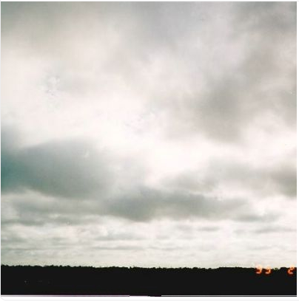
Stratus
Stratus is usually accompanied by little to moderate rainfall

Slide 7
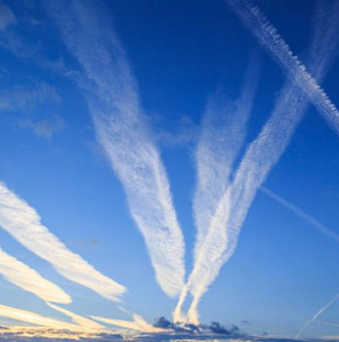
Contrail
Indicates a fair and nice weather ahead

Slide 8
The modern classification scheme classifies clouds according to the altitude of cloud base, there being three altitude classes: low; mid-level and high. Within each altitude class additional classifications are defined based on four basic types and combinations there of.
Weather prediction from the type of cloud can predict upto immediate future and they also indicate change in weather pattern within 24 hours.
To build a multi class classification model for predicting weather from still image provided by the user which has crucial real life application such as environmental monitoring,distinguishing weather phenomenon that can improve local agriculture

Slide 9
03
METHODOLOGY

Slide 10
Dataset Overview
The dataset has features 11 different classes of clouds collected from the Harvard data source.
The dataset contains about 2543 cloud labelled images. Images are of fixed dimensions and the photos are of same sizes 256x256 pixels.Each image has only one cloud category and are saved in separate folder as of the labelled class. Such as Ac, Sc,Ns,Cu,Ci,Cc,Cb,Co etc.

Slide 11
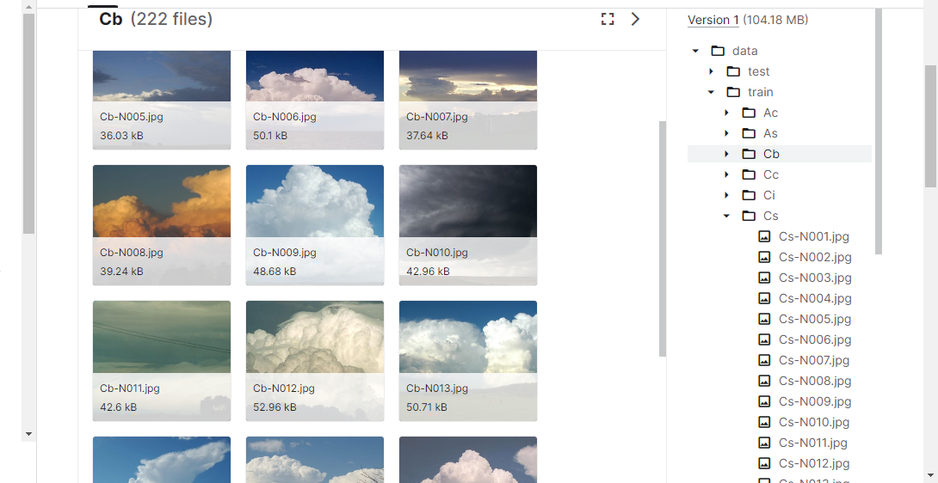

Slide 12
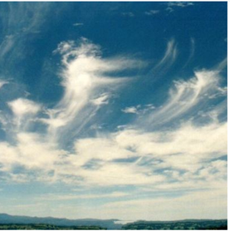
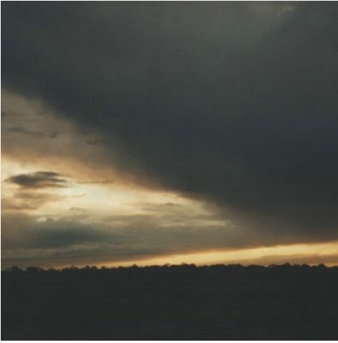
Cirrus
Nimbostratus

Slide 13
05
Test and deployment
Load the data set
01
04
Building models
Train-validation split
.
02
03
Data Preprocessing

Slide 14
Data Preprocessing
Grayscale conversion
Rotation
Flipping
Scaling and Standardizing images

Slide 15
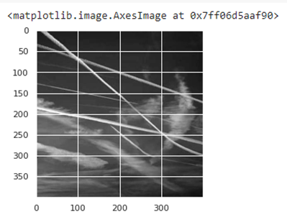
Grayscale conversion
Simplifies the algorithm and reduces computational requirements

Slide 16
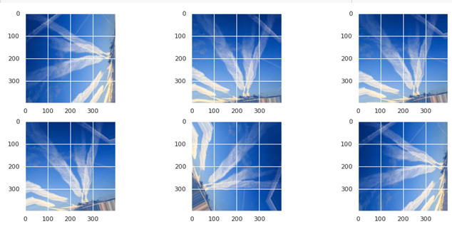
ROTATION
Rotates the image to a specific degree

Slide 17
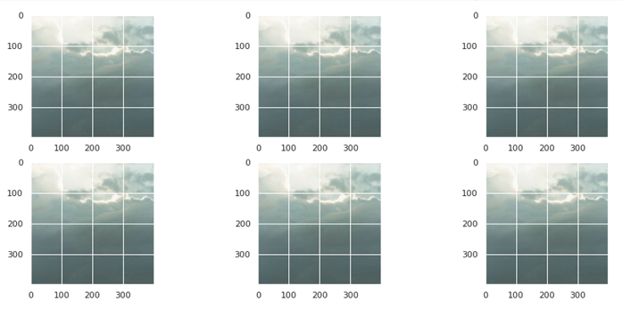
FLIPPING
Reversing the entire rows and columns of an image pixels

Slide 18
Scaling and Standardizing images
Standardization is a method that scales and preprocesses images to have similar heights and widths. It re-scales data to have a standard deviation of 1 and a mean of 0
Data scaling involves projecting image pixels into a predefined range

Slide 19
Building a CNN model

Slide 20
A convolution extracts tiles of input feature map and apply filters to then to compute new features , producing an output feature map.
During training the CNN learns the optimal values for filter matrices that enable it to extract meaningful features from input feature
With the help of CNN, We can build a model that classifies the given still image of a cloud to its correct type and its associated weather pattern

Slide 21
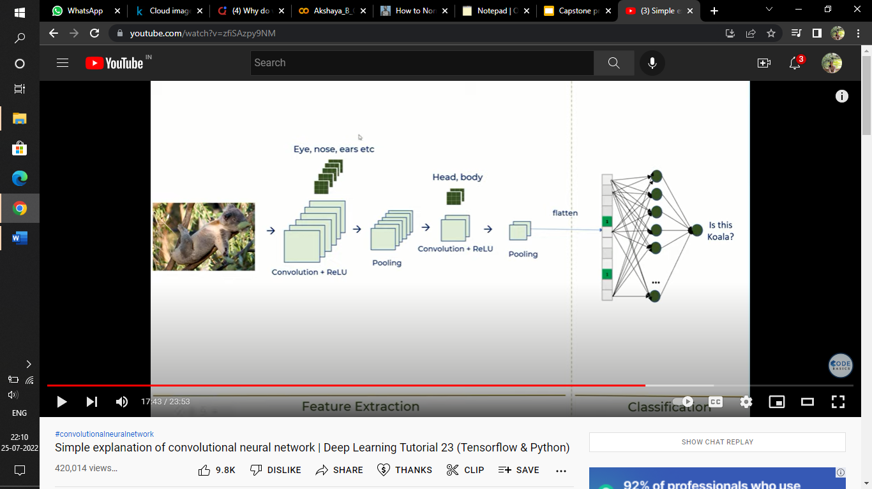
CNN Architecture

Slide 22
The CNN model is built with these layers
Conv2D
Maxpooling2D
Flatten
Relu as activation function
Softmax
Then the model is compiled with
optimizer: Adam
Metrics : Accuracy

Slide 23
Building ResNet50 model

Slide 24
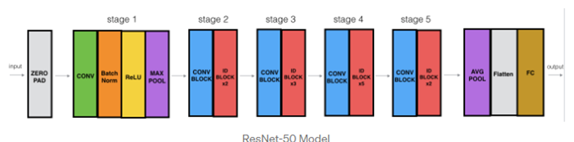
A ResNet50 is CNN that is 50 layers deep along with 1 Maxpool and 1 Average pool layer.The ResNet50 model has 5 stages each with convolution and identity block . each convolution block has 3 convolutional layers nd each identity block also has 3 convolutional layers

Slide 25
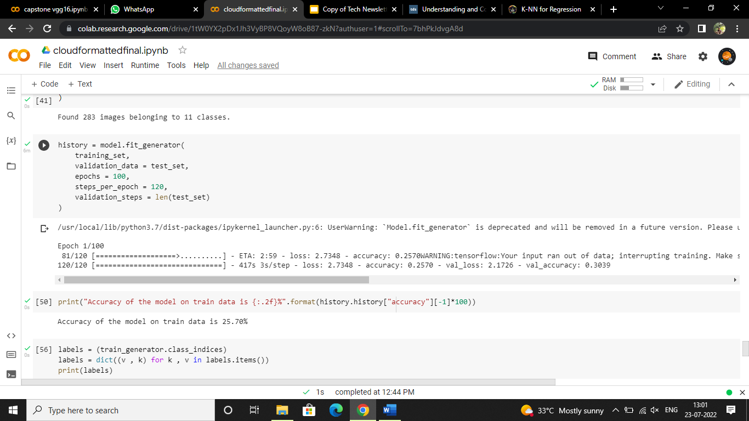
The ResNet50 model is trained with same image preprocessing techniques that were followed on CNN model.
The models yields as accuracy of 25.70% in training set

Slide 26
04
Test and Deployment

Slide 27
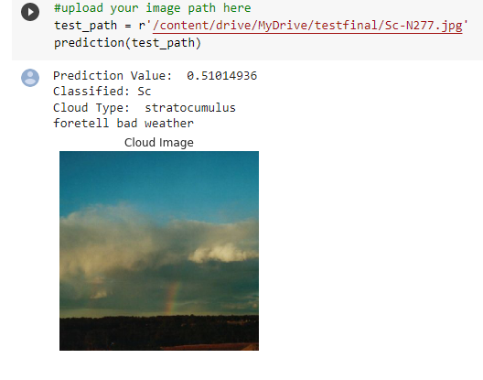
The model is finally tested with a test data and the results are obtained and deployed using vs code and streamlit.
Test using CNN model

Slide 28
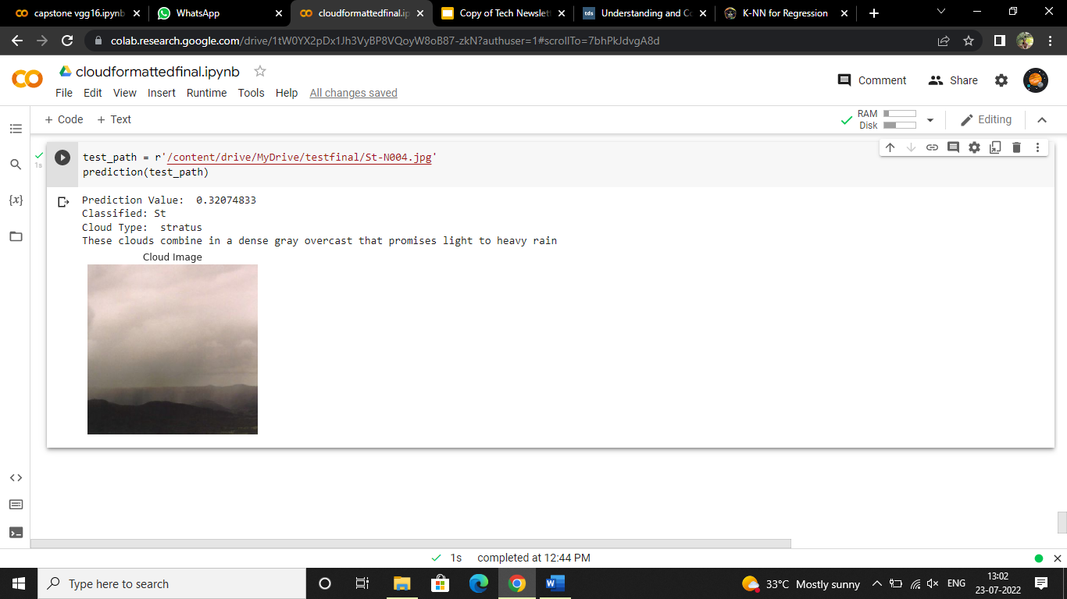
Test using ResNet50

Slide 29
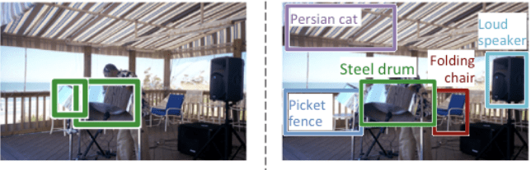
Future works
Applying various Transfer learning algorithm
With object detection using computer vision for identification of cloud types can improve the accuracy of prediction with real life weather pattern and climate can be predicted more accurately.

Slide 30
THANK YOU

